Slide 1
C/C++ datatypes
FRC team # 4941 Programming team
2018 DV Tate Testa

Slide 2
The basics- typing systems
C++ has variables similar to the ones you have in math, but they usually have longer names and can store more than just numbers.
Before you can use a variable, you have to tell the compiler about it or declare it.
The act of setting a variable is called defining the variable

Slide 3
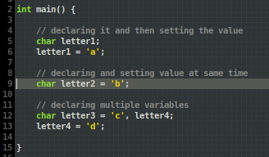
Declaring variables
the general format for making a variable in C/C++ is as follows
`type name = value;`
In the example the type is `char` or character and the value is a character literal (the way the data is represented in the syntax, in this case a single letter enclosed in single quotes)
If a variable doesn't change value it's declaration can start with const

Slide 4
Primitive Datatypes
There are several datatypes in C++ which are built into the language
characters (letters)
integers (whole numbers)
floating point (decimals)
booleans (true/false values)
pointers * (memory addresses)
* = advanced topic

Slide 5
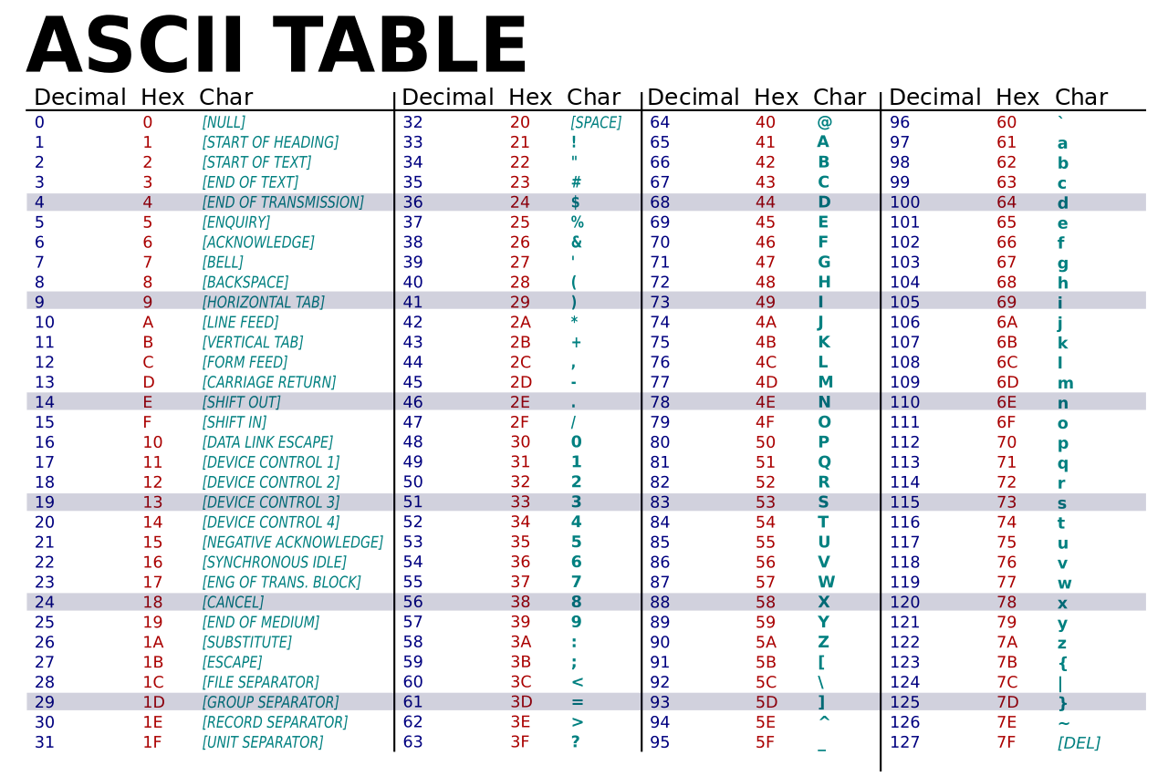
Characters
Characters can represent any letter in the ascii charset
Characters store the ascii value of the character.
literal: single quote enclosed letters (ie - 'a', '\n')

Slide 6
Integers
Integers are the most common datatype in C++ and can be somewhat confusing.
Integers are used to store whole numbers
typename: int (with long, short, signed, and unsigned modifiers) or char
in C variables are assumed to be signed integers
Because we aren't guaranteed to know the size of the primitive integer types I reccomend using inttypes.h for fixed width integers.
literals: a whole number (suffixes can be used to specify type)
special literals: hexidecimal - 0xff (256), octal - 0400 (256), binary - 0b11111111 (256)

Slide 7
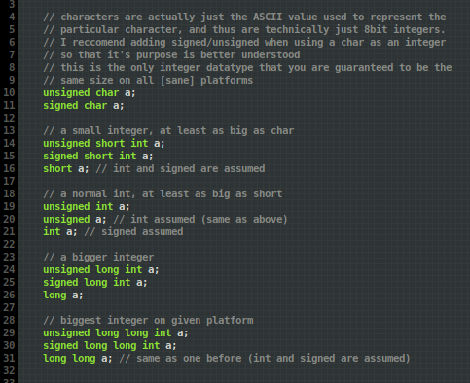
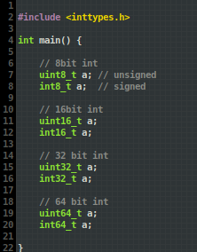
With and without inttypes.h
This lets us use integers of a specific size so that we know the maximum and minimum values they can represent
- typename: [u if unsigned]int[size]_t
-

Slide 8
Floating point numbers
Floating point numbers are used to store numbers which need to hold a decimal. They are better for math.
typename: float, double, long double
literal:
float: a number with a decimal and 'f'/'F' suffix (ie - 2.0f)
double: a number with a decimal (ie - 2.0)
long double: a number with a decimal (ie - 2.0L)
A double is double the size of a float :)

Slide 9
Booleans
useful for storing values where there are only 2 possible outcomes
zero evaluates to false and everything else evaluates to true
literal: true or false
typename: bool

